Slide 1
Inventory Optimization Dashboard

Slide 2
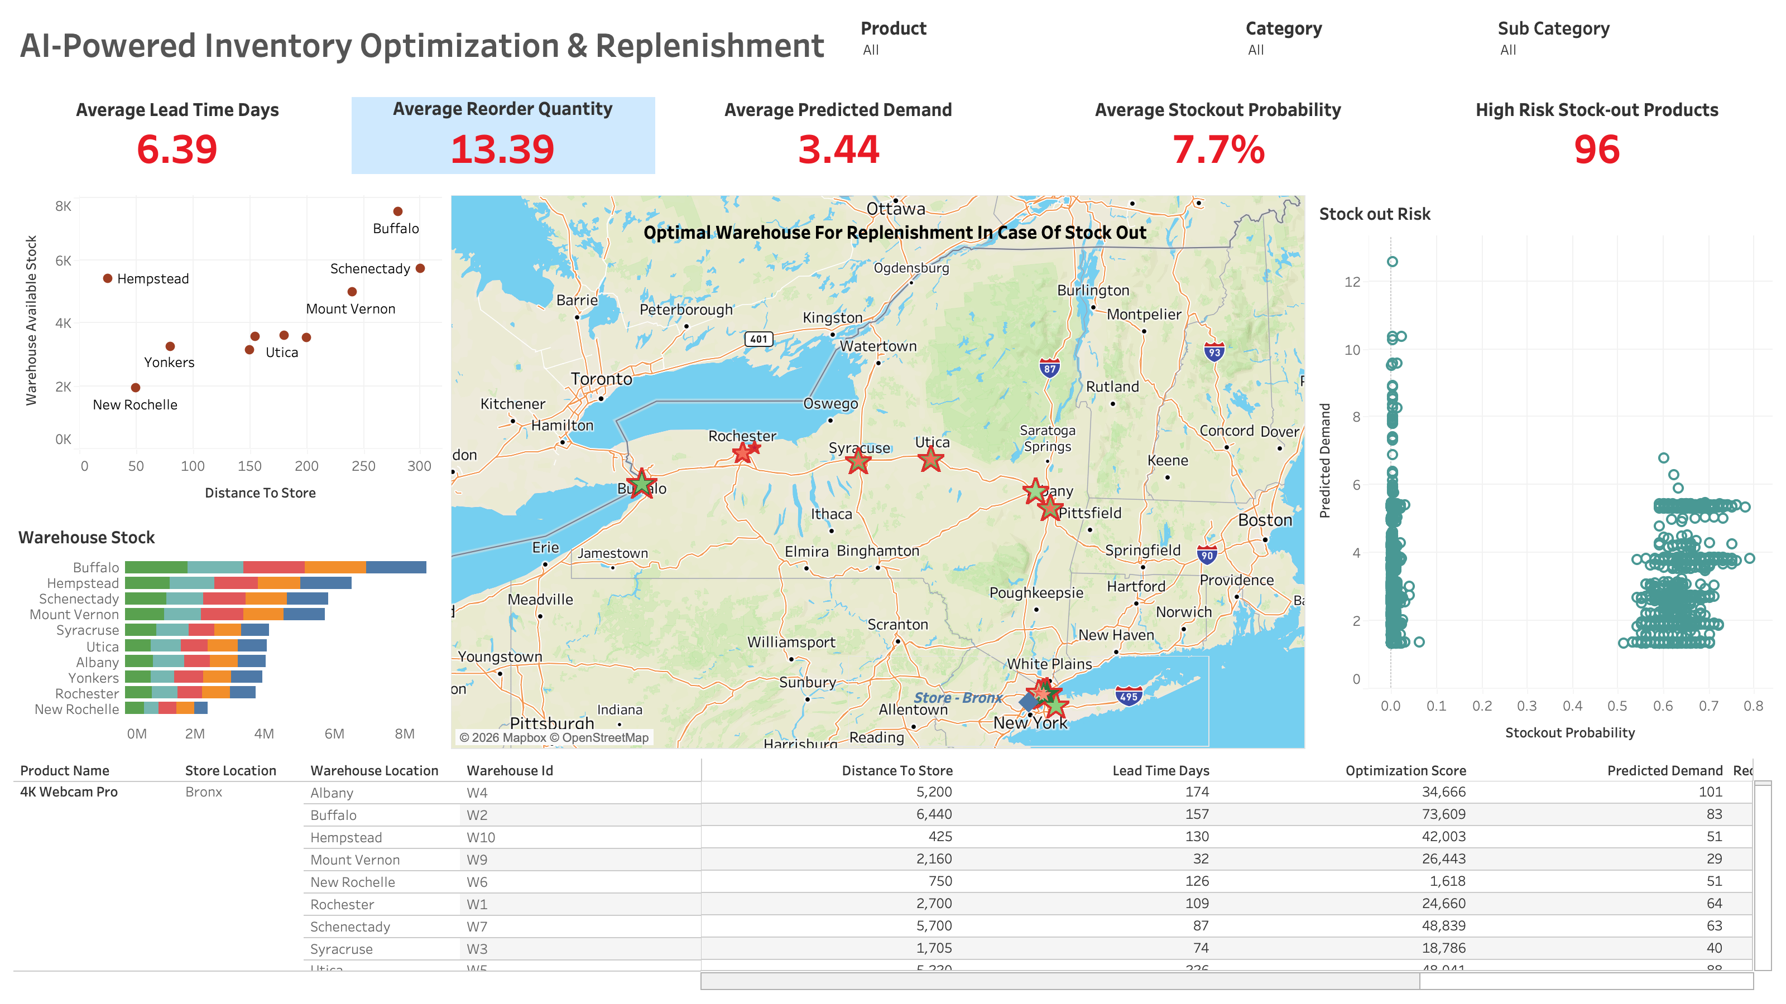

Slide 3
